Slide 1
PIP4004: UNIVERSITY PROJECT Review-0 Presentation Blockchain-based Medical Supply Chain
Batch Number:
Roll number | Student Name
20211ISE0009 | Ayush Aryan
20211ISE0053 | Bushra Begum
Under the Supervision of,
Prof. G Shanmugarathinam
Professor
School of Computer Science and Engineering
Presidency University
Name of the Program: Information Science and Engineering
Name of the HoD: Dr. Pallavi R
Name of the Program Project Coordinator: Prof. Srinivas Mishra
Name of the School Project Coordinators: Dr. Sampath A K / Dr. Abdul Khadar A / Mr. Md Ziaur Rahman

Slide 2
Content
Problem Statement
Github Link
Analysis of Problem Statement
Timeline of the Project
References

Slide 3
Problem Statement Number:
Organization: Blockchain & Healthcare
Category (Hardware / Software / Both) : Software
Problem Description :
The medical supply chain faces challenges such as lack of transparency, counterfeiting, and inefficiencies in tracking. Traditional systems rely on centralized databases, making them vulnerable to fraud, errors, and delays. This project proposes a blockchain-based medical supply chain leveraging smart contracts and QR-based tracking to ensure secure, transparent, and real-time monitoring of medical supplies. Smart contracts will automate processes like order fulfillment and compliance verification, reducing manual intervention and operational risks. QR-based tracking will enable stakeholders to verify product authenticity at each stage, enhancing security and efficiency in healthcare logistics.
Difficulty Level: Simple

Slide 4
Github Link
The Github link provided should have permission to the public.
GitHub Link
https://github.com/bushra866/BlockChain-based-Medical-Supply-Chain

Slide 5
Analysis of Problem Statement
Challenges in Traditional Systems
Lack of Transparency: Centralized databases are prone to fraud and manipulation.
Counterfeiting: Fake medical products threaten patient safety.
Inefficient Tracking: Poor visibility leads to delays and mismanagement.
Manual Processes: Paper-based systems increase errors and compliance issues.
Proposed Solution
A blockchain-powered supply chain using smart contracts for automation and QR-based tracking for real-time verification. This ensures security, transparency, and efficiency in medical logistics.

Slide 6
Analysis of Problem Statement
Technologies Required
Blockchain & Smart Contracts: Ethereum, Solidity QR-Based Tracking: QRCode.js, Google API Backend: Node.js, Python (Flask/Django), Express.js Frontend: React.js, Vue.js, Flutter (for mobile) Storage & Database: IPFS, MongoDB, PostgreSQL Security & Authentication: Metamask, Web3.js, OAuth 2.0, JWT

Slide 7
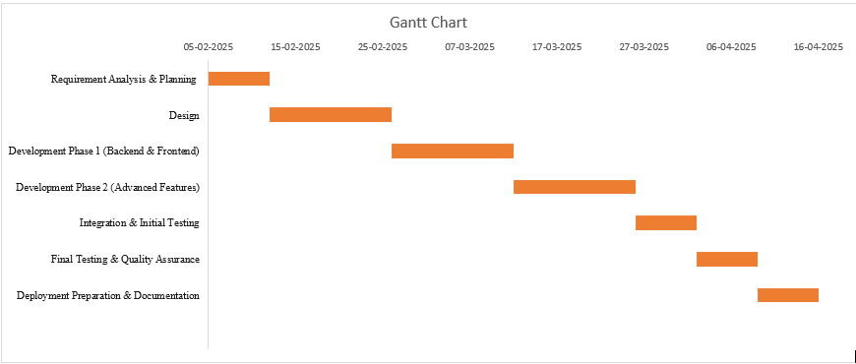
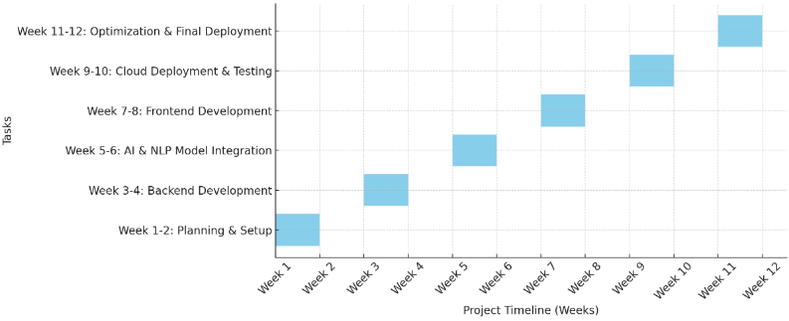
Timeline of the Project (Gantt Chart)

Slide 8
References (IEEE Paper format)
Agarwal, U., Rishiwal, V., Tanwar, S., Chaudhary, R., Sharma, G., Bokoro, P. N., & Sharma, R. (2022). Blockchain technology for secure supply chain management: A comprehensive review. Ieee Access, 10, 85493-85517.
Musamih, A., Salah, K., Jayaraman, R., Arshad, J., Debe, M., Al-Hammadi, Y., & Ellahham, S. (2021). A blockchain-based approach for drug traceability in healthcare supply chain. IEEE access, 9, 9728-9743.
Huang, Y., Wu, J., & Long, C. (2018, July). Drugledger: A practical blockchain system for drug traceability and regulation. In 2018 IEEE international conference on internet of things (iThings) and IEEE green computing and communications (GreenCom) and IEEE cyber, physical and social computing (CPSCom) and IEEE smart data (SmartData) (pp. 1137-1144). IEEE.

Slide 9


